Slide 1
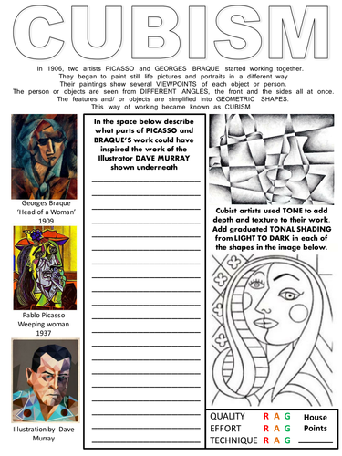
You will need to research on the internet for this activity

