Slide 1
Core Knowledge
1.2 Evaluating new and emerging technologies to inform design decisions
Name:
Group:
Teacher:

Slide 2
1.2 Evaluating new and emerging technologies
Complete the mind map below detailing the questions to ask when critically evaluating new and emerging technologies that inform design decisions.
Key Term: Critical Evaluation: A process that identifies positives and negatives from a range of areas to assess the suitability of concepts such as a design, process or material.
Pages 11-14
Manufacturing Capabilities
Budget Constraints
Examples of critical evaluation questions
Timescale
The Materials Used
Who the Product is for
Name:______________________
Year 10 Core Knowledge

Slide 3
1.2 The evauation of new and emerging technologies
Critical Evaluation 1
List the questions below when considering 3D printing a lower Jaw implant.
1)
2)
3)
4)
5)
6)
Question: How do these questions help with the design process?
Pages 11-14
Consideration of contemporary and potential future scenarios. When making design decisions you must examine possible scenarios. Outcomes could be positive or negative or both.
Page 12 & 13: What are the 5 possible scenarios given, summarise them so you can consider them if you are asked to design something in the exam.
Key terms:
Global warming:
Ethics:

Slide 4
1.2 The evaluation of new and emerging technologies
Ethical perspectives on new and emerging technologies– what are these (give examples):
Pages 11-14
Environment: Why do designers need to consider the environment ? (page 13)
Designers will usually use various types of materials to design and make their products, what considerations should they make and why? (page 14)
Key terms:
Carbon Footprint:
Life-cycle analysis

Slide 5
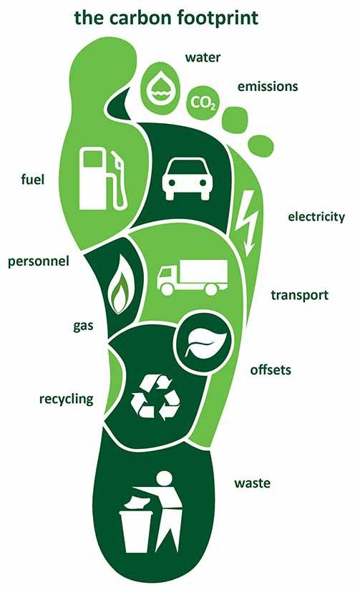
1.2 The evaluation of new and emerging technologies
Carbon Footprint: Your carbon footprint involves all indirect and direct activities in a day.
Give examples of how a company can reduce it’s carbon footprint
Pages 11-14
Draw the key elements of a life-cycle analysis below:
Exam Tip: Ensure you can bullet point the key steps
An LCA is a systematic inventory of environmental impacts at every stage of a product’s life including:

Slide 6
1.2 The evaluation of new and emerging technologies
Pages 11 - 14
List the every day products you use – At least 5
Under one of them list the environmental impact they have – consider the LCA, carbon footprint and the ethical impact,
As a designer, if you were to design a new range of T shirts or timber tech holders, what would your environmental considerations be?
Apple have designed and sold many products, people change their phones sometimes for no reason other than to have the most recent technology. Using the examples on page 12 for a critical evaluation, create a critical evaluation for your favourite gadget or fashion item.

Slide 7
1.2 The evaluation of new and emerging technologies FOT
FOT 1:
Explain the steps involved in carrying out a lifecycle analysis.
Pages 11-14
FOT2: Explain why current and future scenarios needs o be considered when making design decisions.

